Slide 1





DATA STRUCTURE LAB
COURSE CODE: 0613-104
TALKSPACE
PRESENTED BY
PRESENTED TO
02. Mosaddek Hossain Mehedi
17. Saiful Islam
21. Hasibul Hoque Probal
22. Mst. Sultana Yeasmin Suma
40. Azizur Rahman Arzu
MOHIUDDIN HASAN
LECTURER
DEPARTMENT OF CSE
DHAKA INTERNATIONAL UNIVERSITY

Slide 2

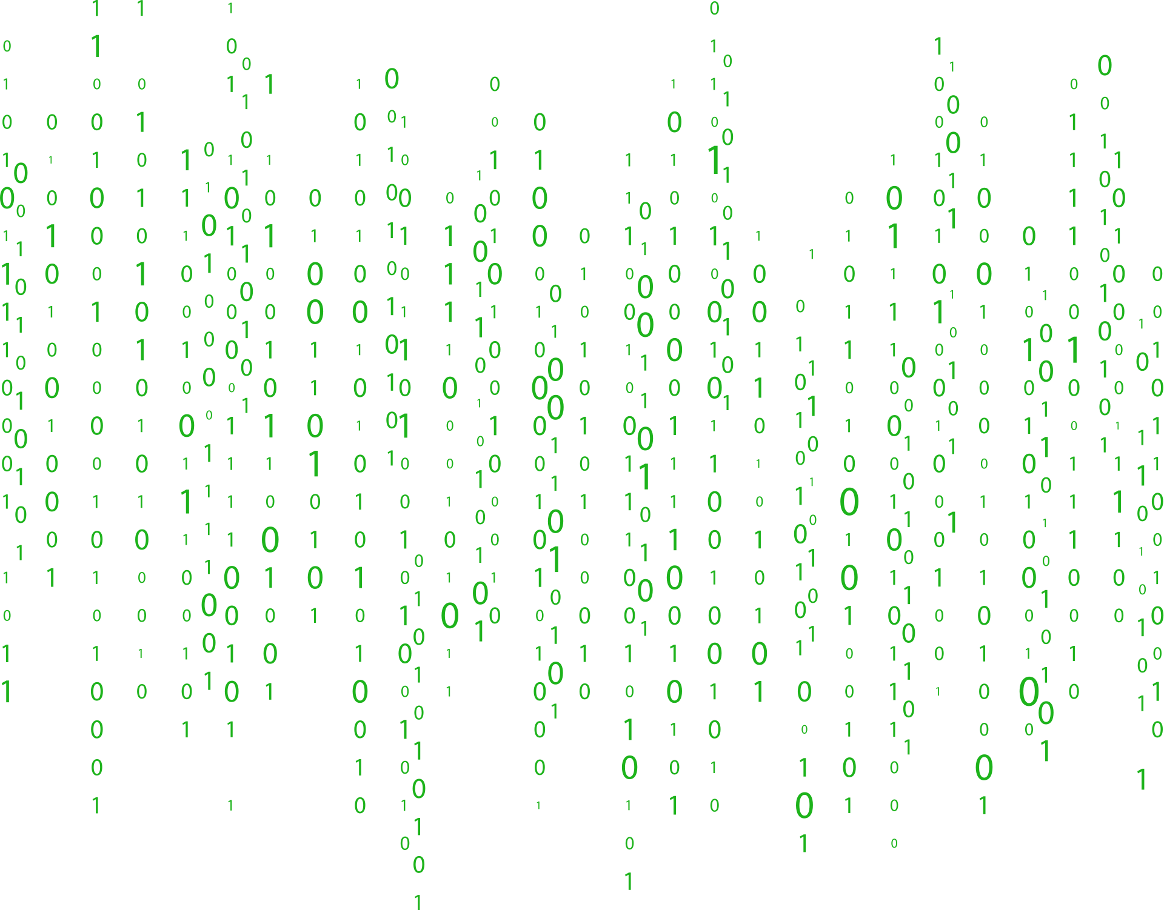
1
INTRODUCTION
TalkSpace is a console based chat system where two users take turns sending messages.The application stores messages using arrays, displays the chat history, includes options to clear history, and has an exit command to stop the chat. The project demonstrates key programming concepts like user input, loops, and array management.

Slide 3
2
FEATURES
Two Users: User1 and User2 take turns sending messages.
Chat History: All sent messages are stored and displayed after each turn.
Clear History: Users can clear the chat history during the chat session.
Exit Command: The chat session can be ended by typing "exit".

Slide 4

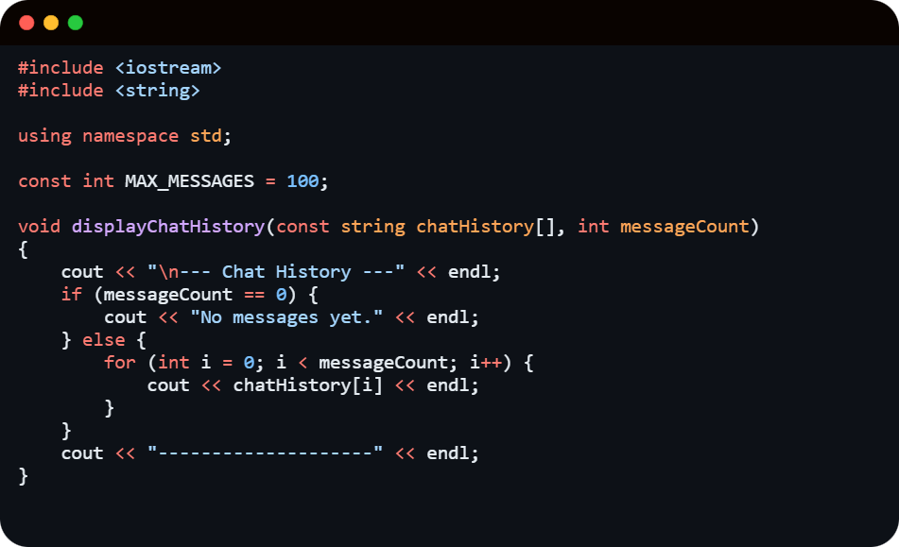
3
CODE EXPLAINATION
displayChatHistory() displays the chat history stored in an array.

Slide 5
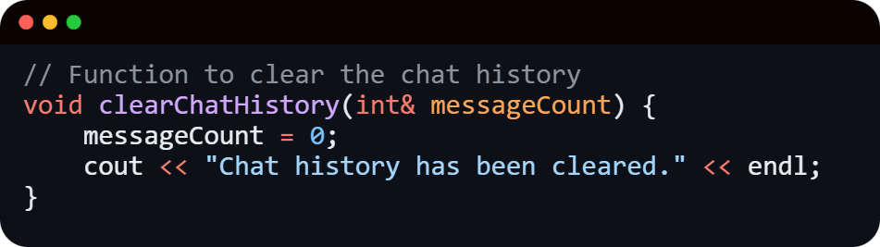
4
CODE EXPLAINATION
clearChatHistory() clears the chat history by resetting the message count.

Slide 6
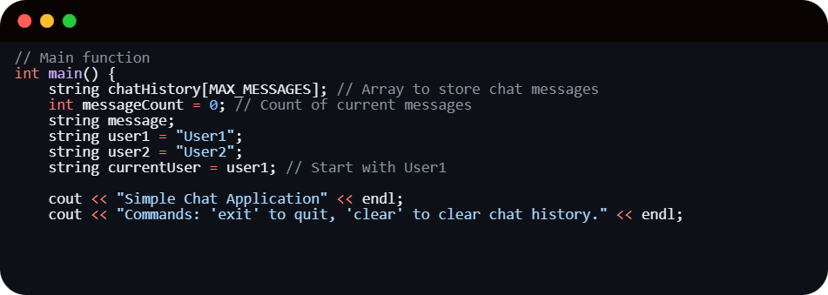
5
CODE EXPLAINATION
The main function handles various user inputs like sendind messages, clearing the history or exiting the chat.

Slide 7
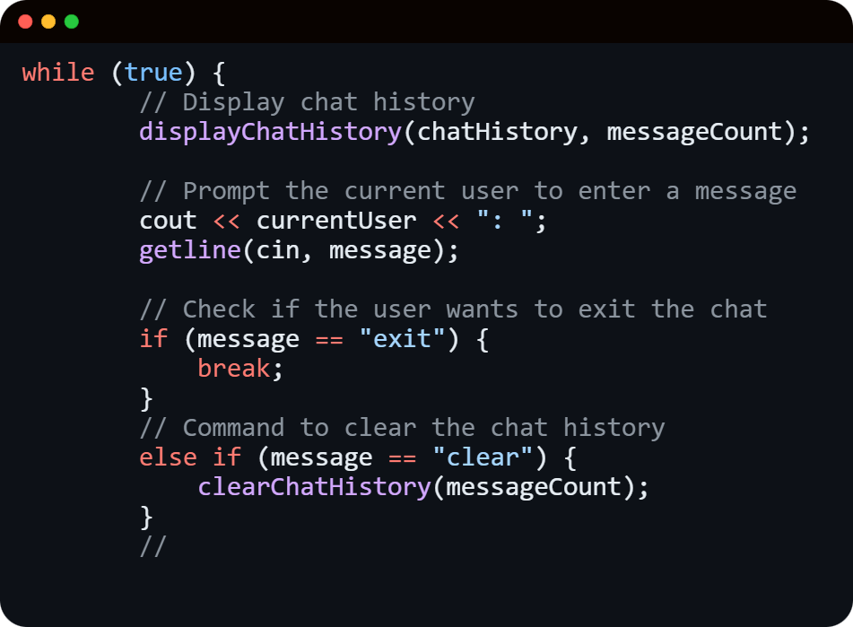
6
CODE EXPLAINATION
This while loop deals with sent messages, clear history, or exit the chat.

Slide 8
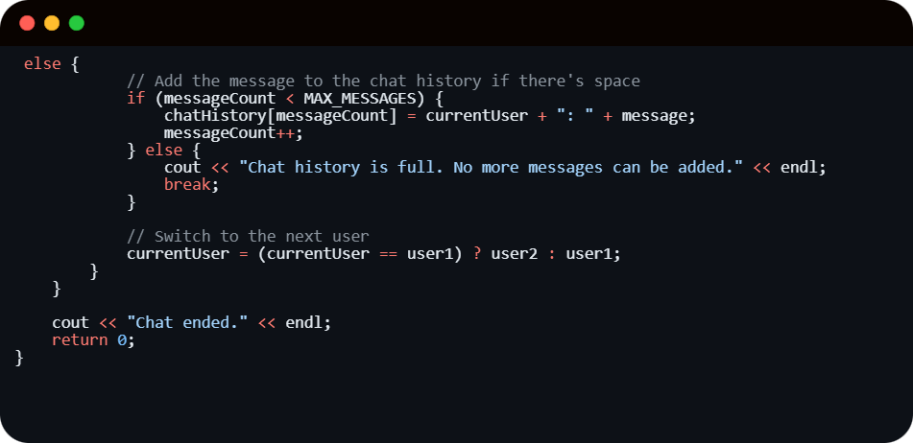
7
CODE EXPLAINATION
Nested conditional statement to add messages into the chat history, checking for space, and switching between users.

Slide 9
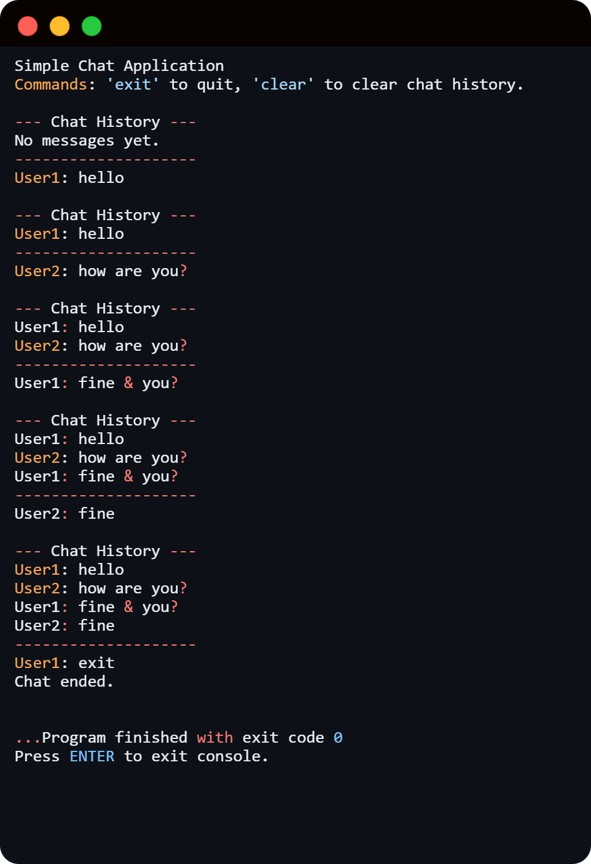
8
OUTPUT
The section displays chat history by looping through the chatHistory array and prints the stored messages. If no messages exist, it informs users.

Slide 10
FUTURE ENHANCEMENTS
9
Custom Usernames: Users can use preferred names instead of using default system-assigned usernames.
Duplicate Username Prevention: Ensures every user selects a unique username to avoid conflicts during chat sessions.
Dynamic History: Limitless conversations without a fixed size limit using vectors.
Edit/Delete Last Message & Search Messages: Users modify or remove recent messages and quickly find past messages using keywords.
Persistent Chat: Saved chat history as to seamlessly continue old conversations.

Slide 11
10
CONCLUSION
The​‍​‌‍​‍‌ project showcases a minimal chatting system for 2 users, with options like save the conversations to see later, removing the chat history, or logging out sessions.

Slide 12


ANY QUESTIONS ?

